Slide 1

CAPSTONE PROJECT SALES ANALYTICS

Slide 2
OVERVIEW
Analyzing sales performance, trends, and key metrics to identify growth opportunities and optimize strategies for improved revenue outcomes.
SUBTITLE:- Sales Data Analysis for the given data.
AYUSH KUMAR

Slide 3
What Is Power BI? Data is an asset and it is highly valuable to businesses. But data alone is difficult to understand and challenging to comprehend. Microsoft’s Power BI is a data visualization tool. It enables users to create dynamic and interactive visualizations of data. Microsoft claims that it is simple enough for anybody to be able to create an effective dashboard and that it can be used by students and schools, as well as data professionals and marketing teams.

Slide 4
OBJECTIVES
The objective of this sales analytics report is to provide a detailed overview of sales performance across various metrics, identify key trends and patterns, and offer actionable insights. This analysis aims to enhance decision-making, optimize sales strategies, and drive revenue growth by leveraging data-driven insights.

Slide 5
SCOPE
The report covers the fiscal year 2023, focusing on key areas such as total sales performance, regional sales distribution, product category analysis, and customer segmentation. It aims to highlight trends, evaluate growth, and uncover opportunities for strategic improvements in sales processes and market reach.

Slide 6
Sales and order analysis - They trends to identify patterns and make data-driven decisions. Customer analysis - To understand distinct needs, behaviors, and characteristics, facilitating targeted strategies and decision-making. Product analysis - It involves categorizing and evaluating product performance and attributes to identify strengths, weaknesses, and opportunities for improvement. Shipping and logistics analysis - It involves evaluating the efficiency, costs, and performance of transportation and supply chain processes to optimize delivery operations and reduce expenses.
EXPLANATION

Slide 7
SALES ANALYTICS
Order Details Analysis | Order Trends | Employee Performance
Analyze order quantities, prices, and discounts. Evaluate order completion rates and average order value. | Assess order trends over time (seasonal, monthly, yearly). Identify peak sales periods and slow periods. | Evaluate sales performance by employee. Assess impact of employee interactions on sales.
Sales and Order Analysis
Customer Demographics | Customer Purchase Behaviour | Customer Lifetime Value
Segment customers based on demographics (age, gender, location). | Analyze purchasing patterns and preferences. Evaluate frequency and volume of purchases. | Calculate the lifetime value of different customer segments.
Customer Analysis
Categories Analysis | Product Performance | Supplier Analysis
Assess sales performance by product categories. Analyze trends within each category. | Evaluate individual product sales. Identify top-selling and low-performing products. | Analyze supplier performance. Assess the impact of supplier relationships on product availability and sales.
Product Analysis
Shipping Analysis | Order Fulfilment | By Order Details
The Shippers table offers insights into shipping costs, efficiency, and potential areas for improvement. | Assess the efficiency of the order fulfillment process. Identify bottlenecks and areas for improvement. | The Order Details table provides a breakdown of each order, including quantities of products sold.
Logistics and Shipping Analysis

Slide 8
ER EXPLANATION
An Entity-Relationship (ER) Diagram visually represents data structures and relationships in a database. It uses entities (objects or concepts like "Customer" or "Product") depicted as rectangles, with attributes (details about entities) shown as ovals. Relationships (connections between entities, such as "places" or "contains") are depicted as diamonds. Cardinality specifies the nature of these connections (e.g., one-to-many). Primary Keys uniquely identify each entity instance. ER diagrams help in designing databases by illustrating how data elements interact, ensuring data integrity, and providing a clear framework for database construction and querying.

Slide 9
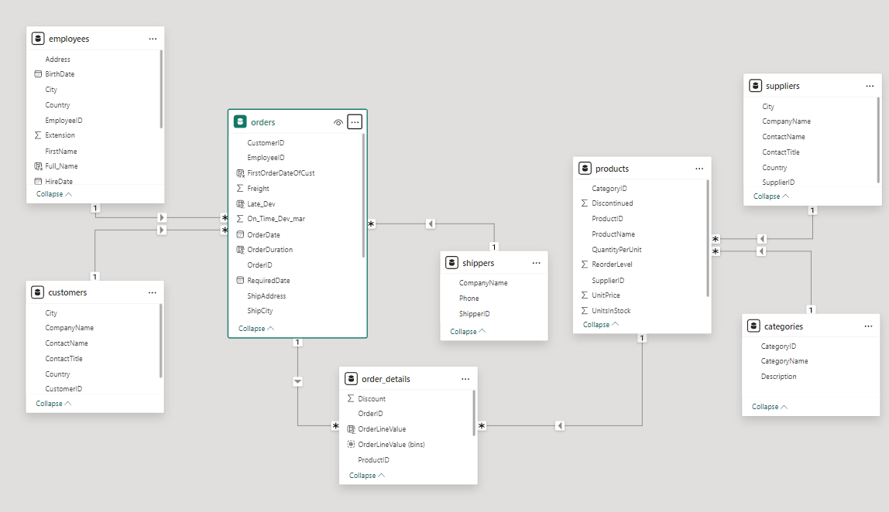

Slide 10
Title: Key Sales Metrics
Content:
Total Sales: The total revenue generated over the specified period. This metric provides a comprehensive view of overall sales performance.
Sales Growth: The percentage increase or decrease in sales compared to the previous period. This helps evaluate the success of sales strategies and market trends.
Market Share: The company's percentage of total market sales compared to competitors. This indicates the company's competitive position within the industry.
Visual:
PowerBI Screenshot/Infographic:
Total Sales: Display a bar chart or a table from PowerBI showing total sales figures.
Sales Growth: Use a line chart or area graph to illustrate changes in sales growth over time.
Market Share: Present a pie chart or donut chart from PowerBI to show the company’s market share relative to competitors.

Slide 11
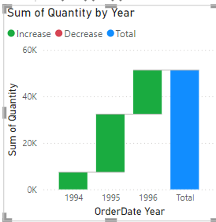
Example Layout:
Title: Key Sales Metrics
Content:
Total Sales: $X million (Y% increase from previous period)Sales
Growth: Z% growth (compared to [Previous Period/Quarter/Year])Market Share: A% of total market
Visual:

Slide 12
Slide Title: Sales Performance by Region
Content:
Overview: This section highlights how sales are distributed across different regions or territories. Understanding regional performance helps identify high-performing areas and regions needing improvement.
Key Metrics:
Total Sales by Region: Compare sales figures across various regions to determine which areas are driving the most revenue.
Sales Growth by Region: Evaluate how sales have changed over time in different regions.
Regional Market Share: Analyze each region's contribution to the overall market share.

Slide 13
Visual:
PowerBI Screenshot/Infographic:
Map Visualization: Include a map from PowerBI showing sales distribution across different regions. Highlight regions with the highest and lowest sales.
Bar Chart: Present a bar chart or column chart from PowerBI depicting total sales figures for each region.
Regional Breakdown: Use a table or pie chart from PowerBI to show the proportion of total sales attributed to each region.
Example Layout:
Title: Sales Performance by Region
Content:
Total Sales by Region: Overview of sales figures across all regions.
Sales Growth by Region: Growth percentages for each region.
Regional Market Share: Market share distribution by region.
Visual:

Slide 14
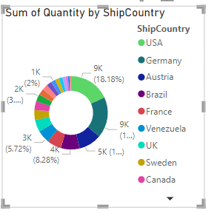
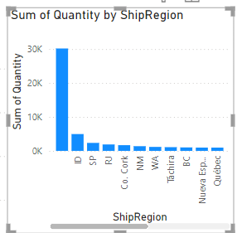
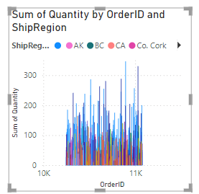

Slide 15
SALES TRENDS OVER TIME
Title: Sales Trends Over Time
Content:
Overview: Analyze how sales figures have evolved over the specified period to identify trends and patterns. This helps in understanding seasonal effects, market dynamics, and the impact of various sales strategies.
Key Points:
Overall Trend: Highlight the general direction of sales over time (e.g., upward, downward, or stable).
Seasonal Patterns: Identify any recurring patterns or fluctuations in sales that correspond to different times of the year.
Impact of Events: Note any significant events or promotions that may have influenced sales trends.

Slide 16
Visual:
PowerBI Line Chart/Time Series Graph:
Line Chart: Include a line chart from PowerBI showing sales data across the specified period. This visual should depict changes in sales over time, with clear markers for significant peaks or troughs.
Time Series Graph: Alternatively, use a time series graph to illustrate sales performance, showing trends, seasonality, and anomalies.
Example Layout:
Title:
Sales Trends Over Time
Content:
Overall Trend: Describe the general direction of sales (e.g., increasing steadily, experiencing seasonal highs and lows).
Seasonal Patterns: Point out any seasonal variations in sales figures.
Impact of Events: Mention any specific events or strategies that significantly impacted sales.
Visual:[Insert PowerBI Line Chart/Time Series Graph Here]

Slide 17
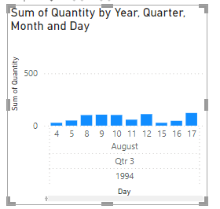

Slide 18
CUSTOMER SEGMENTATION
Content:
Overview: Analyze different customer segments and their impact on overall sales. Understanding customer segmentation helps tailor marketing strategies and optimize sales approaches for each group.
Key Insights:
Segment Contributions: Highlight how each customer segment contributes to total sales, identifying the most profitable or largest segments.
Behavioral Trends: Discuss any notable purchasing behaviors or preferences within different segments.
Opportunities for Growth: Identify potential opportunities for targeting underperforming or emerging segments.

Slide 19
Visual:
PowerBI Pie Chart/Bar Chart:
Pie Chart: Include a pie chart from PowerBI showing the proportion of total sales attributed to each customer segment. This visual will illustrate how each segment contributes to overall revenue.
Bar Chart: Alternatively, use a bar chart from PowerBI to display sales figures for each segment, providing a clear comparison of segment performance.
EXAMPLE LAYOUT
Content:
Segment Contributions: Breakdown of total sales by different customer segments (e.g., demographics, purchase frequency).
Behavioral Trends: Insights into purchasing behaviors within segments.
Opportunities for Growth: Areas to focus on for improving sales within various segments.
Visual:

Slide 20
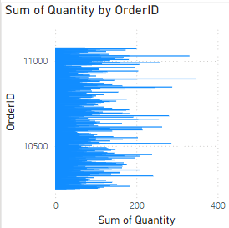
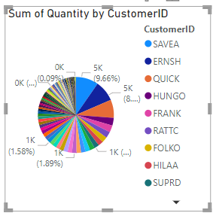

Slide 21
Product Performance
Content:
Overview: Evaluate the performance of various products or product categories to understand their contributions to total sales and profitability. This analysis helps identify high-performing products and areas where improvements are needed.
Key Insights:
Top Performers: Highlight which products are generating the most revenue and which are the most popular among customers.
Underperformers: Identify products that are not meeting sales expectations and explore potential reasons for their underperformance.
Sales Trends: Discuss any trends in product performance, such as seasonal variations or shifts in customer preferences.

Slide 22
Visual:
PowerBI Bar Chart/Product Performance Matrix:
Bar Chart: Include a bar chart from PowerBI showing sales figures for each product. This visual allows for easy comparison of product performance.
Product Performance Matrix: Alternatively, use a product performance matrix from PowerBI to provide a more detailed view of various metrics such as sales volume, revenue, and profit margins across different products.
Example Layout:
Content:
Top Performers: Products with the highest sales figures and revenue.
Underperformers: Products falling short of sales targets.
Sales Trends: Observations on how product performance varies over time or seasonally.
Visual:[Insert PowerBI Bar Chart Here][Insert PowerBI Product Performance Matrix Here]

Slide 23
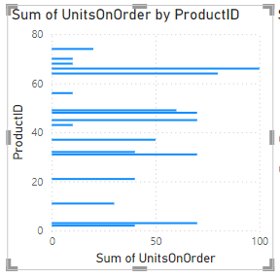
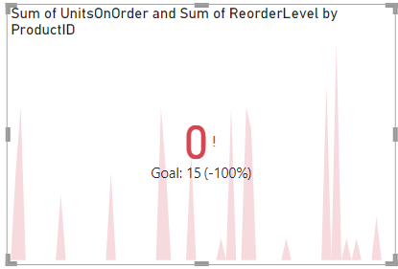

Slide 24
Key Insights and Recommendations
Content:
Key Insights:
Sales Performance: Highlight major trends observed in overall sales performance, such as growth areas or declines.
Regional Insights: Summarize findings related to regional sales performance and any notable geographic patterns.
Customer Segmentation: Outline important observations about customer segments and their impact on sales.
Product Performance: Summarize which products are performing well and which are underperforming.

Slide 25
Recommendations:
Strategy Adjustments: Suggest specific strategies to enhance sales performance based on the insights, such as targeted marketing campaigns or sales promotions.
Focus Areas: Recommend focusing on high-performing regions or customer segments to maximize growth.
Product Optimization: Propose actions for improving the performance of underperforming products, such as adjusting pricing, enhancing features, or modifying the marketing approach.
Future Monitoring: Advise on metrics and trends to monitor moving forward to ensure continued growth and identify new opportunities.

Slide 26
Challenges and Opportunities
Challenges:
Declining Sales in Key Regions: Identify regions where sales are decreasing and potential reasons (e.g., market saturation, competition).
Underperforming Products: Highlight products that are not meeting sales expectations and possible causes (e.g., lack of market fit, poor marketing).
Customer Retention Issues: Discuss any difficulties in retaining customers and factors contributing to churn (e.g., customer dissatisfaction, better competitor offerings).
Operational Constraints: Note any internal issues affecting sales performance (e.g., supply chain disruptions, limited resources).

Slide 27
Opportunities:
Market Expansion: Explore potential new markets or regions where the company could grow its sales.
Product Innovation: Suggest opportunities for developing new products or improving existing ones to meet customer needs.
Enhanced Marketing Strategies: Recommend targeted marketing efforts or new promotional campaigns to boost sales.
Customer Engagement: Propose strategies to improve customer retention and loyalty, such as personalized experiences or loyalty programs.

Slide 28
Conclusion
Content:
Recap of Main Points:
Sales Performance Overview: Summarize key sales metrics, trends, and overall performance.
Regional Analysis: Highlight insights from regional sales data and significant findings.
Customer Segmentation: Recap important details about customer segments and their contributions to sales.
Product Performance: Summarize the performance of key products and any notable trends.
Challenges and Opportunities: Review identified challenges and potential growth opportunities.

Slide 29
Final Thoughts:
Strategic Implications: Emphasize how the findings should inform strategic decisions and actions.
Next Steps: Suggest immediate actions or follow-up analyses to address challenges and leverage opportunities.
Encouragement for Action: Encourage stakeholders to use the insights for improving sales strategies and achieving business goals.
Visual:
Optional: Summary Infographic or Key Takeaways:
Infographic: A visual summary highlighting key metrics, insights, and recommendations in a visually engaging format.
Key Takeaways: A concise list of the most important points from the analysis, presented as bullet points or a simple graphic.

Slide 30
THANK YOU

